Slide 1
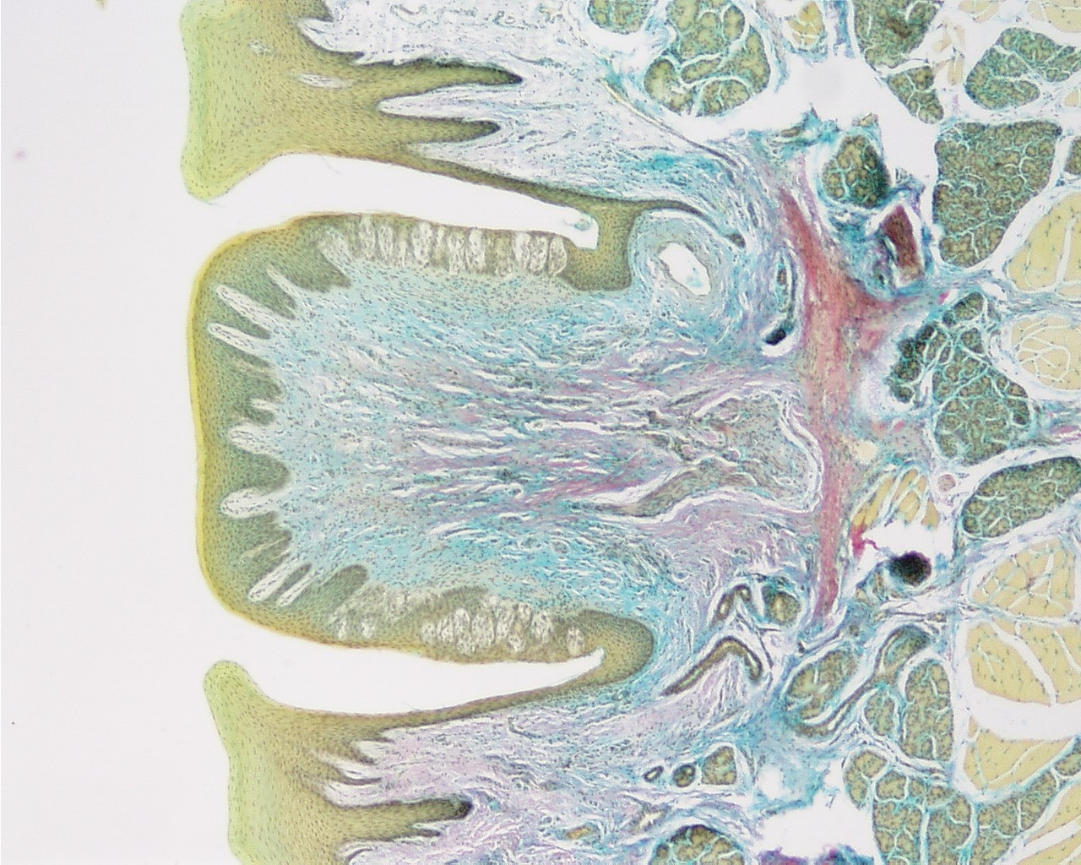
Tastebud 40x
1 mm

Slide 2
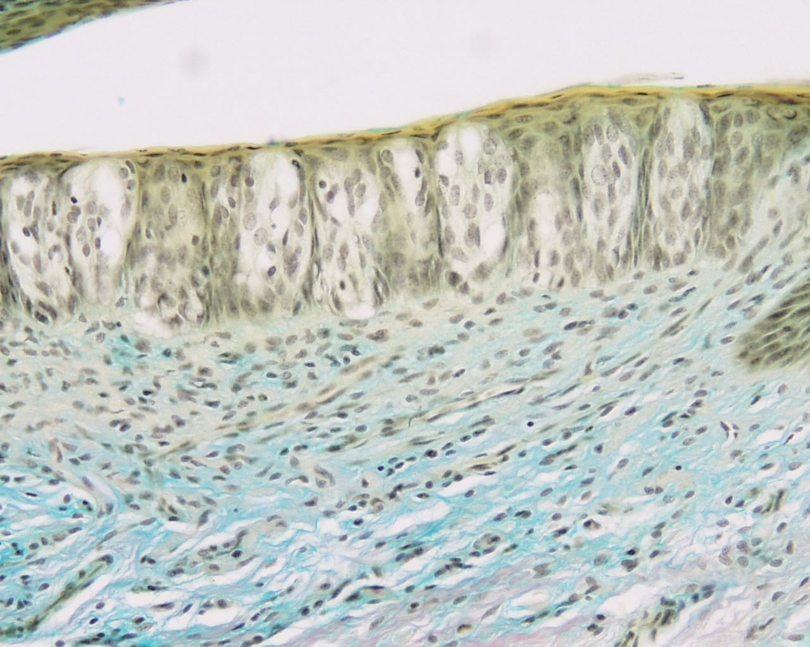
Tastebud 200x
0.2 mm

Slide 3
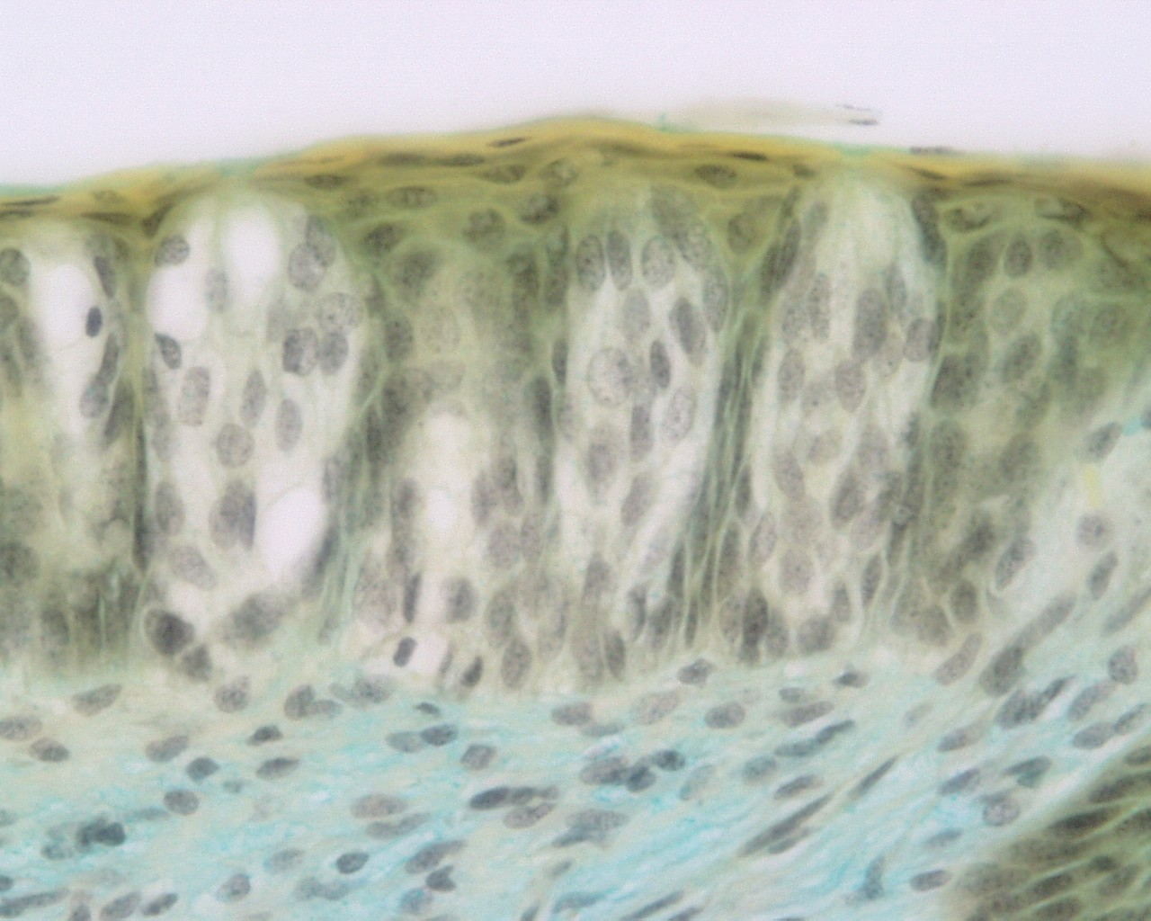
Tastebud 400x
10μm squares
0.1 mm

Slide 4
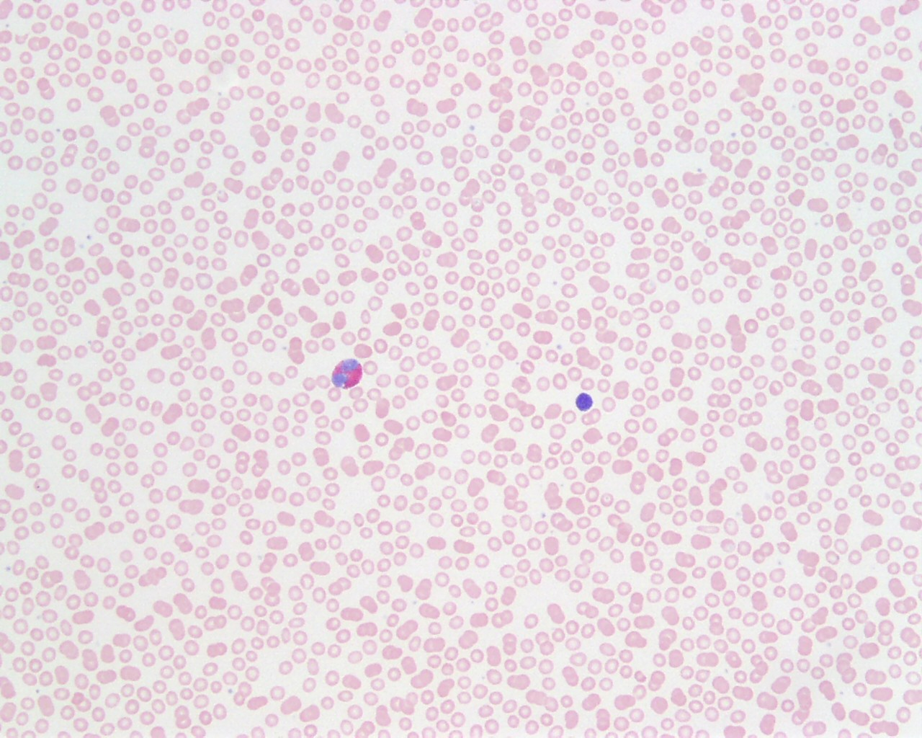
Blood 200x
0.2 mm

Slide 5
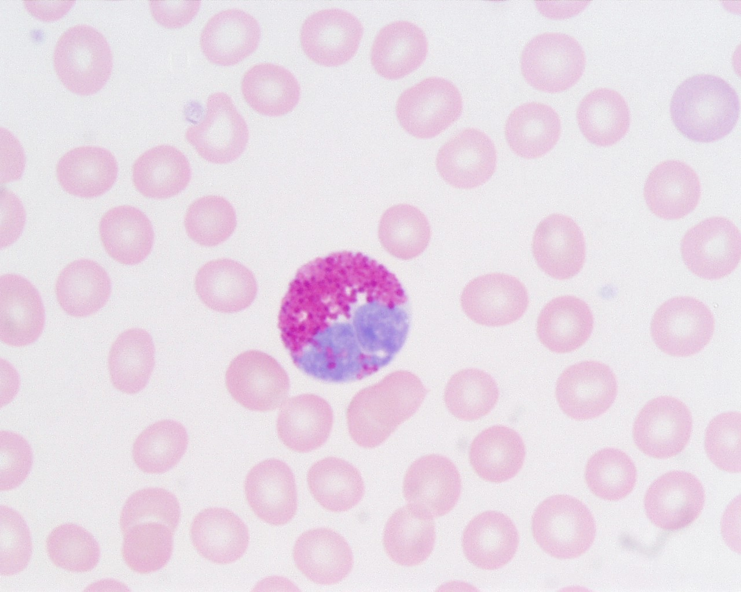
10µm squares
White blood cell 1000x

Slide 6
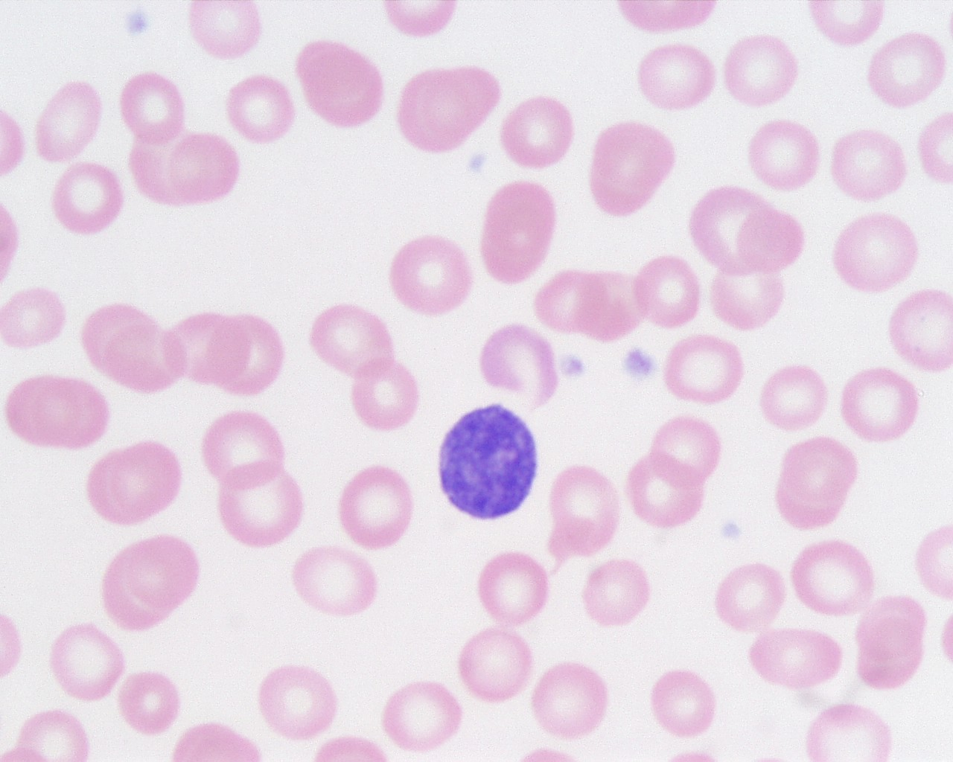
White blood cell 1000x
10µm squares

